Slide 1
Front End Web
CSS & HTML Best Practices Review and Discussion

Slide 2
Separating structural, style, and interactive makes your life easier
HTML
CSS
JS
Orientation | CSS Fundamentals | Tools & Standards | Page Structure, Accessibility, & SEO | Strategy & Next Steps
Notes:
Separation of formatting and content makes it possible to present the same markup page in different styles for different rendering methods, such as on-screen, in print, by voice (via speech-based browser or screen reader), and on Braille-based tactile devices. It can also display the web page differently depending on the screen size or viewing device. Readers can also specify a different style sheet, such as a CSS file stored on their own computer, to override the one the author specified.

Slide 3
Keeping your code separated is a start
Efficient Code is a next step
Utilize the cascade
Reduce clutter / utilize comments
Coordinate format and organization
Validate
Orientation | CSS Fundamentals | Tools & Standards | Page Structure, Accessibility, & SEO | Strategy & Next Steps

Slide 4
What is CSS
Cascading Style Sheets (CSS) is a style sheet language used for describing the presentation of a document written in a markup language.
CSS is designed primarily to enable the separation of presentation and content.
Improve content accessibility
Increase flexibility and control in the specification of presentation
Enable multiple HTML pages to share formatting
Reduce complexity and repetition in the structural content
Orientation | CSS Fundamentals | Tools & Standards | Page Structure, Accessibility, & SEO | Strategy & Next Steps

Slide 5
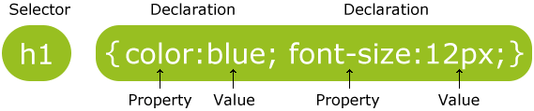
What is a CSS Rule
Orientation | CSS Fundamentals | Tools & Standards | Page Structure, Accessibility, & SEO | Strategy & Next Steps

Slide 6
Cascade
CSS is an acronym of Cascading Style Sheets, which indicates that the notion of the cascade is important. At its most basic level it indicates that the order of CSS rules matter, but it's more complex than that. What selectors win out in the cascade depends on three factors (these are listed in order of weight — earlier ones will overrule later ones):
Source order
Importance
Specificity
Source: https://en.wikipedia.org/wiki/Cascading_Style_Sheets#Selector
Orientation | CSS Fundamentals | Tools & Standards | Page Structure, Accessibility, & SEO | Strategy & Next Steps

Slide 7
Source order
body { color: #CCC; } /* All text inherits the color grey */
h1 { color: #008000; } /* h1 text will be green */
h1 { color: #800000; } /* h1 text color will overwrite to maroon*/
<head> <link rel="stylesheet" href="css/style.css"> <style> h1 { color: #0000ff; } /* h1 text will be blue on this page */ </style> </head> <body>
<h1 style=“color:FF0000”>Hello There</h1> <!– this h1 will be red -->
</body>
Orientation | CSS Fundamentals | Tools & Standards | Page Structure, Accessibility, & SEO | Strategy & Next Steps

Slide 8
!important
body { color: #CCC; } /* All text will be grey */
h1 { color: #008000 !important; } /* h1 text will be green */
<head> <link rel="stylesheet" href="css/style.css"> <style> h1 { color: #0000ff; } /* h1 text will be blue on this page */ </style> </head> <body>
<h1 style=“color:FF0000”>Hello There</h1> <!– this h1 will be green -->
</body>
!important can be a life saver – but it’s inefficient and often leads to unexpected results for future coders. It should be used rarely -- Better to utilize controlled inheritance and SPECIFICITY
Orientation | CSS Fundamentals | Tools & Standards | Page Structure, Accessibility, & SEO | Strategy & Next Steps

Slide 9
Controlling inheritance
CSS provides three special values to handle inheritance:
inherit : This value sets the property value applied to a selected element to be the same as that of its parent element.
initial : This value sets the property value applied to a selected element to be the same as the value set for that element in the browser's default style sheet. If no value is set by the browser's default style sheet and the property is naturally inherited, then the property value is set to inherit instead.
unset : This value resets the property to its natural value, which means that if the property is naturally inherited it acts like inherit, otherwise it acts like initial.
body { color: green; }
.inherit a { color: inherit; }
.initial a { color: initial }
.unset a { color: unset; }
Source: https://developer.mozilla.org/en-US/docs/Learn/CSS/Introduction_to_CSS/Cascade_and_inheritance
Orientation | CSS Fundamentals | Tools & Standards | Page Structure, Accessibility, & SEO | Strategy & Next Steps

Slide 10
Specificity
Specificity is a measure of how specific a selector is
Element selectors have low specificity.
Class selectors have a higher specificity, so will win against element selectors.
ID selectors have an even higher specificity, so will win against class selectors.
The only way to win against an ID selector is to use !important.
Source: https://developer.mozilla.org/en-US/docs/Learn/CSS/Introduction_to_CSS/Cascade_and_inheritance
Orientation | CSS Fundamentals | Tools & Standards | Page Structure, Accessibility, & SEO | Strategy & Next Steps

Slide 11
Specificity Continued
The amount of specificity a selector has is measured using four different values (or components), which can be thought of as thousands, hundreds, tens and ones — four single digits in four columns:
Thousands: Score one in this column if the matching selector is inside a <style> element or the declaration is inside a style attribute (such declarations don't have selectors, so their specificity is always simply 1000.) Otherwise 0.
Hundreds: Score one in this column for each ID selector contained inside the overall selector.
Tens: Score one in this column for each class selector, attribute selector, or pseudo-class contained inside the overall selector.
Ones: Score one in this column for each element selector or pseudo-element contained inside the overall selector.
Source: https://developer.mozilla.org/en-US/docs/Learn/CSS/Introduction_to_CSS/Cascade_and_inheritance
Orientation | CSS Fundamentals | Tools & Standards | Page Structure, Accessibility, & SEO | Strategy & Next Steps

Slide 12
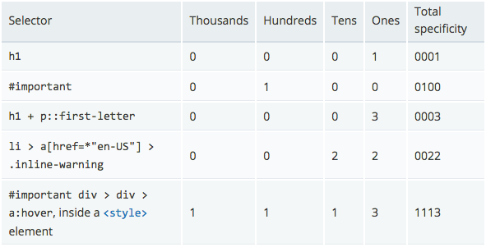
Specificity Score
Source: https://developer.mozilla.org/en-US/docs/Learn/CSS/Introduction_to_CSS/Cascade_and_inheritance
Orientation | CSS Fundamentals | Tools & Standards | Page Structure, Accessibility, & SEO | Strategy & Next Steps

Slide 13
Selectors
https://en.wikipedia.org/wiki/Cascading_Style_Sheets#Selector
Orientation | CSS Fundamentals | Tools & Standards | Page Structure, Accessibility, & SEO | Strategy & Next Steps

Slide 14
Transforms // Transitions // Animations
Source: https://www.w3schools.com/css/css3_2dtransforms.asp
Orientation | CSS Fundamentals | Tools & Standards | Page Structure, Accessibility, & SEO | Strategy & Next Steps

Slide 15
Transforms
CSS3 transforms allow you to translate, rotate, scale, and skew elements.
A transformation is an effect that lets an element change shape, size and position.
CSS3 supports 2D and 3D transformations.
Source: https://www.w3schools.com/css/css3_2dtransforms.asp
Orientation | CSS Fundamentals | Tools & Standards | Page Structure, Accessibility, & SEO | Strategy & Next Steps

Slide 16
Transitions
CSS3 transitions allows you to change property values smoothly (from one value to another), over a given duration.
Source: https://www.w3schools.com/css/css3_transitions.asp
Orientation | CSS Fundamentals | Tools & Standards | Page Structure, Accessibility, & SEO | Strategy & Next Steps

Slide 17
Animations
CSS3 animations allows animation of most HTML elements without using JavaScript or Flash!
Source: https://www.w3schools.com/css/css3_animations.asp
Orientation | CSS Fundamentals | Tools & Standards | Page Structure, Accessibility, & SEO | Strategy & Next Steps

Slide 18
CSS 2 @media
The @media rule, introduced in CSS2, made it possible to define different style rules for different media types.
Examples: You could have one set of style rules for computer screens, one for printers, one for handheld devices, one for television-type devices, and so on.
Unfortunately these media types never got a lot of support by devices, other than the print media type.
Source: https://www.w3schools.com/css/css3_mediaqueries.asp
Orientation | CSS Fundamentals | Tools & Standards | Page Structure, Accessibility, & SEO | Strategy & Next Steps

Slide 19
CSS 3 @media
Media queries in CSS3 extend the CSS2 media types idea: Instead of looking for a type of device, they look at the capability of the device.
Media queries can be used to check many things, such as:
width and height of the viewport
width and height of the device
orientation (is the tablet/phone in landscape or portrait mode?)
Resolution
@media screen and (min-width: 480px) {
body { background-color: lightgreen; }
}
Source: https://www.w3schools.com/css/css3_mediaqueries.asp
Orientation | CSS Fundamentals | Tools & Standards | Page Structure, Accessibility, & SEO | Strategy & Next Steps

Slide 20
CSS FORMAT BEST PRACTICES
Make it readable
.someDiv { background: red; padding: 2em; border: 1px solid black; }
.someDiv { background: red; padding: 2em; border: 1px solid black; }
Keep it consistent
Use a Reset
Source: https://code.tutsplus.com/tutorials/30-css-best-practices-for-beginners--net-6741
Orientation | CSS Fundamentals | Tools & Standards | Page Structure, Accessibility, & SEO | Strategy & Next Steps

Slide 21
CSS FORMAT BEST PRACTICES Continued
Organize the Stylesheet with a Top-down Structure
Generic classes (body, a, p, h1, etc.)
#header
#nav-menu
#main-content
Utilize comments to separate sections
/****** main content *********/
styles goes here...
/****** footer *********/
styles go here...
Combine Elements
h1, h2, h3 {font-family: tahoma, color: #333}
Source: https://code.tutsplus.com/tutorials/30-css-best-practices-for-beginners--net-6741
Orientation | CSS Fundamentals | Tools & Standards | Page Structure, Accessibility, & SEO | Strategy & Next Steps

Slide 22
CSS FORMAT BEST PRACTICES Cont.
Create Your HTML First
Form follows function
Use Multiple Classes
<div class="box right"></div>
Use Shorthand
#crayon { margin-left: 5px; margin-right: 7px; margin-top: 8px; } VS #crayon { margin: 8px 7px 0px 5px; // top, right, bottom, and left values, respectively. }
Source: https://code.tutsplus.com/tutorials/30-css-best-practices-for-beginners--net-6741
Orientation | CSS Fundamentals | Tools & Standards | Page Structure, Accessibility, & SEO | Strategy & Next Steps

Slide 23
CSS FORMAT BEST PRACTICES Final notes
Comment your CSS
Make Use of Generic Classes
Avoid Extra Selectors
body #container .someclass ul li {....} VS .someclass li {...}
VALIDATE
Source: https://code.tutsplus.com/tutorials/30-css-best-practices-for-beginners--net-6741
Orientation | CSS Fundamentals | Tools & Standards | Page Structure, Accessibility, & SEO | Strategy & Next Steps

Slide 24


Slide 25
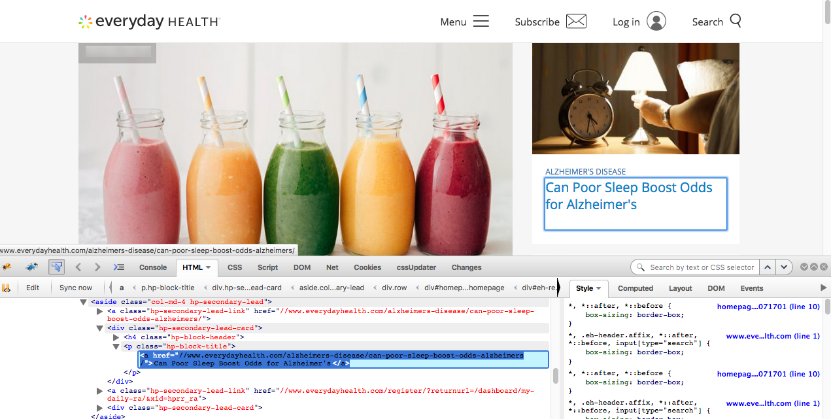
The Inspector
Orientation | CSS Fundamentals | Tools & Standards | Page Structure, Accessibility, & SEO | Strategy & Next Steps

Slide 26
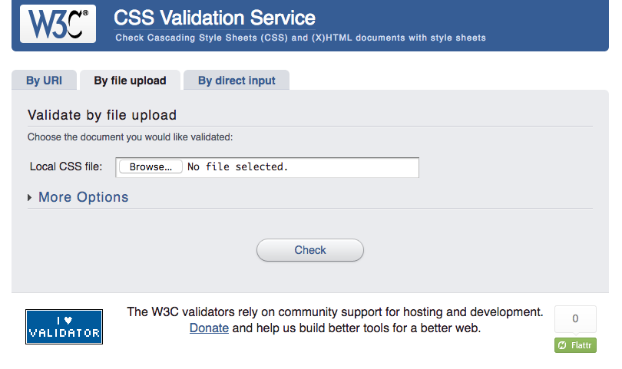
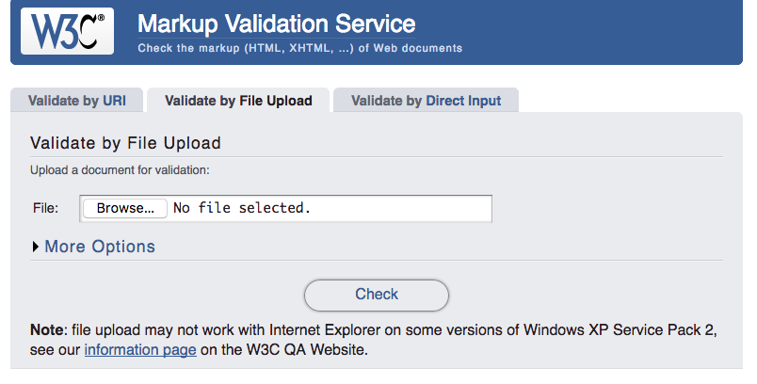
W3C Validation Tool
https://jigsaw.w3.org/css-validator/
https://validator.w3.org
Orientation | CSS Fundamentals | Tools & Standards | Page Structure, Accessibility, & SEO | Strategy & Next Steps

Slide 27
Be nice: validate
Validation as a debugging tool
Validation as a future-proof quality check
Validation eases maintenance
Validation helps teach good practices
Validation is a sign of professionalism
Source: https://validator.w3.org/docs/why.html
Orientation | CSS Fundamentals | Tools & Standards | Page Structure, Accessibility, & SEO | Strategy & Next Steps
Notes:
Validation as a debugging tool
While contemporary Web browsers do an increasingly good job of parsing even the worst HTML “tag soup”, some errors are not always caught gracefully. Very often, different software on different platforms will not handle errors in a similar fashion, making it extremely difficult to apply style or layout consistently.
Using standard, interoperable markup and stylesheets, on the other hand, offers a much greater chance of having one's page handled consistently across platforms and user-agents. Indeed, most developers creating rich Web applications know that reliable scripting needs the document to be parsed by User-Agents without any unexpected error, and will make sure that their markup and CSS is validated before creating a rich interactive layer.
When surveyed, a large majority of Web professionals will state that validation errors is the first thing they will check whenever they run into a Web styling or scripting bug.
Validation as a future-proof quality check
Checking that a page “displays fine” in several contemporary browsers may be a reasonable insurance that the page will “work” today, but it does not guarantee that it will work tomorrow.
In the past, many authors who relied on the quirks of Netscape 1.1 suddenly found their pages appeared totally blank in Netscape 2.0. Whilst Internet Explorer initially set out to be bug-compatible with Netscape, it too has moved towards standards compliance in later releases.
Validation is one of the simplest ways to check whether a page is built in accordance with Web standards, and provides one of the most reliable guarantee that future Web platforms will handle it as designed.
Validation eases maintenance
It is reasonable to consider that standards such as HTML and CSS are a form of “coding style” which is globally agreed upon. Creating Web pages or applications according to a widely accepted coding style makes them easier to maintain, even if the maintenance and evolution is performed by someone else.
Validation helps teach good practices
Many professionals have been authoring the Web with HTML and CSS for years and know these technologies by heart. Beginners and students, on the other hands, will find automated checking tools invaluable in spotting mistakes. Some teachers also stress that automated validation tests are a good introduction to broader, more complex quality concepts such as accessibility.
Validation is a sign of professionalism
As of today, there is little or no certification for Web professionals, and only few universities teach Web technologies, leaving most Web-smiths to learn by themselves, with varied success. Seasoned, able professionals will take pride in creating Web content using semantic and well-formed markup, separation of style and content, etc. Validation can then be used as a quick check to determine whether the code is the clean work of a seasoned HTML author, or quickly hacked-together tag soup.

Slide 28

HTML Email Check
Source: https://www.htmlemailcheck.com/
Orientation | CSS Fundamentals | Tools & Standards | Page Structure, Accessibility, & SEO | Strategy & Next Steps

Slide 29
Speed is important
If an e-commerce site is making $100,000 per day,
a 1 second page delay could potentially cost
$2.5 million in lost sales every year.
Source: https://blog.kissmetrics.com/loading-time/
Orientation | CSS Fundamentals | Tools & Standards | Page Structure, Accessibility, & SEO | Strategy & Next Steps

Slide 30
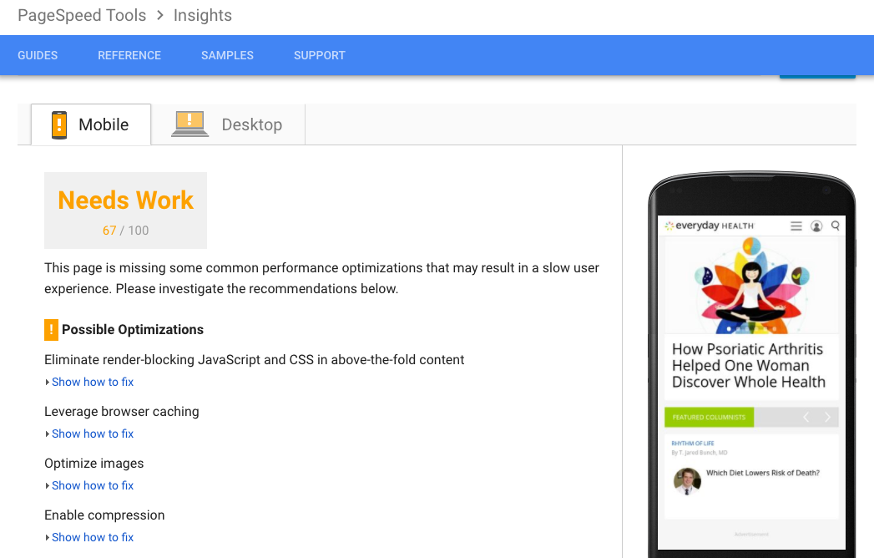
PageSpeed Insights
https://developers.google.com/speed/pagespeed/insights/
Orientation | CSS Fundamentals | Tools & Standards | Page Structure, Accessibility, & SEO | Strategy & Next Steps

Slide 31


Slide 32
Hierarchy
Shows
Where to look
and when
Orientation | CSS Fundamentals | Tools & Standards | Page Structure, Accessibility, & SEO | Strategy & Next Steps

Slide 33
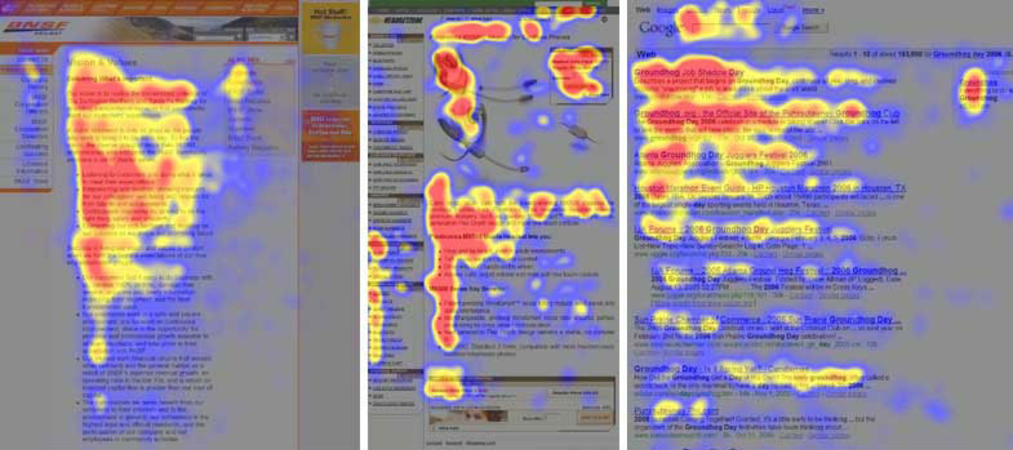
The F Pattern
Orientation | CSS Fundamentals | Tools & Standards | Page Structure, Accessibility, & SEO | Strategy & Next Steps

Slide 34
Machines utilize hierarchy too
Search Engine Optimization
SEO is a marketing discipline focused on growing visibility in organic (non-paid) search engine results. SEO encompasses both the technical and creative elements required to improve rankings, drive traffic, and increase awareness in search engines. There are many aspects to SEO, from the words on your page to the way other sites link to you on the web. Sometimes SEO is simply a matter of making sure your site is structured in a way that search engines understand.
Web Accessibility
Web accessibility means that people with disabilities can use the Web. More specifically, Web accessibility means that people with disabilities can perceive, understand, navigate, and interact with the Web, and that they can contribute to the Web. Web accessibility also benefits others, including older people with changing abilities due to aging.
Source: https://moz.com/beginners-guide-to-seo
Source: https://www.w3.org/WAI/intro/accessibility.php
Orientation | CSS Fundamentals | Tools & Standards | Page Structure, Accessibility, & SEO | Strategy & Next Steps

Slide 35
Improved SEO + Accessibility through HTML structure
<title> tags
SEO
Provides context as to what the page is about when Google crawls it
Influences how the page appears in the search result display. Over the years, while SEO techniques have come and gone and fluctuated in perceived effectiveness, page titles have continued to be one of the more highly valued on-page tactics.
Accessibility
This criterion benefits all users in allowing users to quickly and easily identify whether the information contained in the web page is relevant to their needs.
People with visual disabilities will benefit from being able to differentiate content when multiple web pages are open.
People with cognitive disabilities, limited short-term memory, and reading disabilities also benefit from the ability to identify content by its title.
This criterion also benefits people with severe mobility impairments whose mode of operation relies on audio when navigating between Web pages.
Source: https://moz.com/blog/global-accessibility-awareness-day
Orientation | CSS Fundamentals | Tools & Standards | Page Structure, Accessibility, & SEO | Strategy & Next Steps

Slide 36
Improved SEO + Accessibility through HTML structure continued
Headings (H1, H2, H3, H4)
SEO
An H1 heading indicates the main topic of a page, while H2–H6 indicate subtopics or page sections.
Accessibility
Headings allow assistive technologies to quickly navigate a page. Headings define the structure of the page and a screen reader user will oftentimes use these as the first method to move to a particular module or region of content.
Source: https://moz.com/blog/global-accessibility-awareness-day
Orientation | CSS Fundamentals | Tools & Standards | Page Structure, Accessibility, & SEO | Strategy & Next Steps

Slide 37
Improved SEO + Accessibility through HTML structure dos and don’ts
Heading do’s and don’ts
Do use headings. It’s important not to skip headings.
Don’t use more than one H1 heading: HTML5 allows for multiple H1s, but this is not well-supported by browsers/assistive technology.
Do use headings to define sections of content. For example, use H2 headings for subheader or key sections of the page and H3 headings for content modules.
Don’t use headings if there's no following content. Headings define sections of content, so if there is no content section, it shouldn’t have a header.
Source: https://moz.com/blog/global-accessibility-awareness-day
Orientation | CSS Fundamentals | Tools & Standards | Page Structure, Accessibility, & SEO | Strategy & Next Steps

Slide 38
Improved SEO + Accessibility through HTML structure appropriate elements
Utilize the appropriate element tags
One H1 per page – should contain information about the page and keywords It is permitted in HTML5 sections to have more than one
Headings create divisions in page content
Lists in <ul> or <ol> tags
<strong> and <em> for emphasis not <b> or <i>
Add title and alt attributes to all images
Content will be read by spiders and screen readers in the order it’s coded Place the most important information toward the top
Organize pages with HTML5 semantic elements <header>, <main>, <section>, <aside>, <footer>, etc.
Orientation | CSS Fundamentals | Tools & Standards | Page Structure, Accessibility, & SEO | Strategy & Next Steps

Slide 39
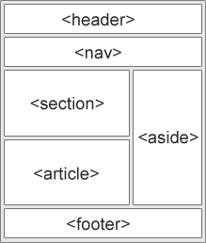
Improved SEO + Accessibility through HTML structure – Symantec Headers
Source: https://www.w3schools.com/html/html5_semantic_elements.asp
Orientation | CSS Fundamentals | Tools & Standards | Page Structure, Accessibility, & SEO | Strategy & Next Steps

Slide 40


Slide 41

CSS is evolving. Livelong learning is a must.
Animations in CSS
Calculating Values
Advanced Selectors
Counters
Gradients
Webfonts
Box Sizing
Media Queries
Border Images
Multiple Backgrounds
CSS Columns
CSS 3D Transformations
Filters
Data uri
@supports
@namespace
Orientation | CSS Fundamentals | Tools & Standards | Page Structure, Accessibility, & SEO | Strategy & Next Steps
Notes:
https://developer.mozilla.org/en-US/docs/Web/CSS/calc
https://developer.mozilla.org/en-US/docs/Web/CSS/CSS_Lists_and_Counters/Using_CSS_counters
https://www.w3schools.com/css/css3_gradients.asp
https://www.w3schools.com/cssref/css3_pr_columns.asp
https://css-tricks.com/almanac/properties/f/filter/
https://css-tricks.com/data-uris/

Slide 42

CSS is evolving. Livelong learning is a must… CSS is moving forward
https://davidwalsh.name/css4-preview
https://cloudfour.com/thinks/building-themes-with-css4-color-features/
https://www.w3.org/TR/2011/WD-selectors4-20110929/
https://www.w3.org/
Orientation | CSS Fundamentals | Tools & Standards | Page Structure, Accessibility, & SEO | Strategy & Next Steps

Slide 43

The End
Orientation | CSS Fundamentals | Tools & Standards | Page Structure, Accessibility, & SEO | Strategy & Next Steps

